Slide 1


Acoustic scene classification
Cognitive Computing and Artificial Intelligence 2024
University of Catania, Italy
2023-2024

Slide 2
Team
Aldo Barca 1000050457
Francesco Cerruto 1000005927
Giovanni Traina
1000053629

Slide 3

Introduction
Acoustic scene classification is an important task based on recognizing given an audio, in which type of environment the audio was taken of. The difficulty of the task is based on the noisy environment and the variability of sounds which every environment can have.
Moreover, gathering lots of data is really hard, considering the privacy laws, so it’s really hard to have considerable datasets.

Slide 4
Task specification
The key points of the project are:
Train a network using fine-tuning
Use TUT 17 Dataset
Perform training 3 times, varying the portion of usable data of the dataset (100%, 50% and 10%)
Test the network created with good results

Slide 5
Our key ideas
We choose to use Audio Spectrogram Transformer (AST) pre-trained on AudioSet. AST can be easily synthetized as the equivalent of ViT for Audio instead of Images. As a transformer, a state of art architecture, it can grant great performances. In particular when there is temporal (in an audio scenario) correlation or sequential correlation (in a speech scenario). This particularity is thanks to its core difference from other architectures, the attention.
Use data augmentation for audio to improve generalization, reducing overfitting and even make model more resilient to variation and noises in inference. The data augmentation is not done to increase the dataset size, considering the already polished version we used.
Lastly we decided to use to evaluate model performances under three scenarious, pure fine-tuning, shallow prompt-tuning and deep prompt-tuning.

Slide 6
TUT 17
The dataset used by our model is TUT 17 development set. It’s composed by 4680 audio of 15 different acoustic scenes. Every audio is exactly 10s, therefore there is no different duration audio problem (really dangerous for Audio Processing Models).
The dataset has labels divided in 12 files, already divided in 4-folds. For each fold there is a file called foldn_train.txt, foldn_evaluate.txt and foldn_test.txt. Each file is written in a csv format and contains the audio name and the matching true acoustic scene of the audio (label).
We decided to use only train and evaluate files because evaluate and test files contains the same information minus the labels. We perform validation phase using a fraction of the train set data.
The fold-divided structure of the dataset is designed to let 4-folds cross-validation be easy to do. The dataset creator decided to use a 0.666 fraction of the audio for the train and the remaining 0.333 for the evaluation (test), for a total of 3510 audio for training and 1170 for testing.
Other than development dataset, used during the training phase, we used TUT 17 evaluation dataset to evaluate our models.

Slide 7
The model
AST, acronym of Audio Spectrogram Transformer, as the name suggest is a Transformer type model based on spectrogram inputs. Therefore it’s literally made for audio processing.
In our case we are taking the AST pre-trained model using the ASTModel class from the transformers library. The ASTModel class return us an AST pre-build and pre-trained model without the classification head (fully connected/ linear layer).
This allow us to fine tune the already pre-trained model on our task-specific dataset, creating and adding to the model a perfectly suitable task-oriented classifier head.

Slide 8
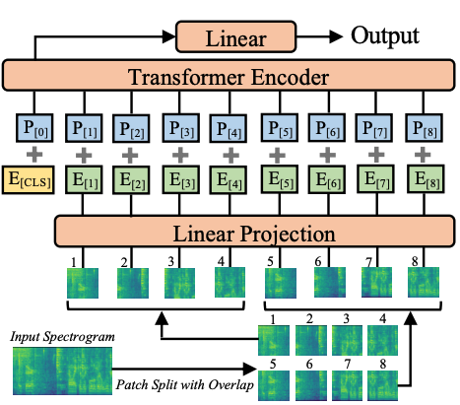
Given the spectrogram input, firstly it is given to a linear projection layer where features extracted from the spectrogram are turned into a higher dimensional space.
Then the input is passed on a positional encoding layer so that AST does a positional encoding of the spectrograms, so that it knows the position of the various features in the spectrogram.
Lastly the encoder, key component of a transformer model thanks to the attention mechanism, captures the different relationships between various part of the spectrogram. At the top of the architecture it’s used a classification layer for the classification task.
AST Architecture

Slide 9
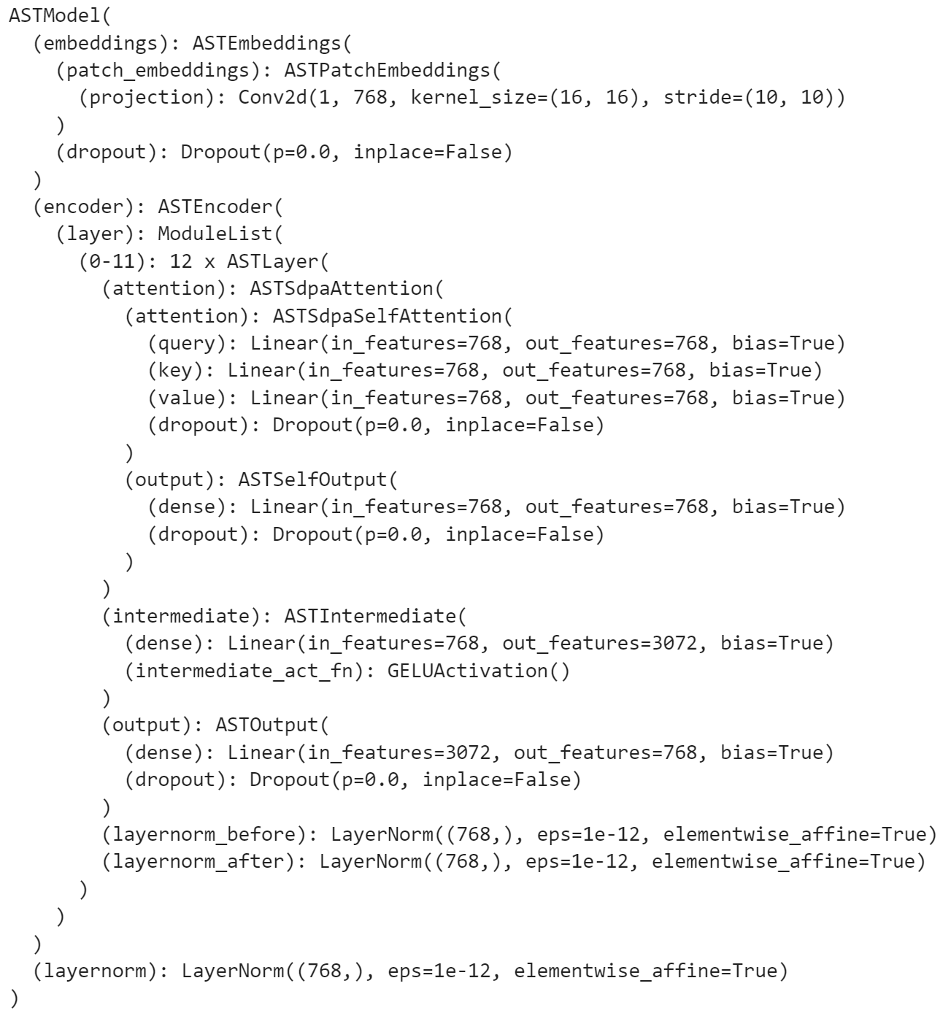
Notes:
Note: Si usa la GeLu, Gaussian Error Linear Unit come Funzione di attivazione in alcuni layer dell’encoder, rispetto alla classica ReLu la GeLu evita meglio l’overfitting e lavora meglio con valori negativi dei neuroni.

Slide 10
Data Pre-Processing
From a data pre-processing point of view we use the AST feature extractor from the class ASTFeatureExtractor.
Given an audio loaded by librosa we perform audio data augmentation, using the following transformations:
Shift time : Tecnique which creates new version of the audio, shifting the time. It helps avoiding overfitting thanks to the variation of the data. Moreover it helps handling delays and advances during inference phase.
shift = np.random.randint(len(audio) * 0.2
audio = np.roll(audio, shift)
Amplification: Amplify the audio to capture better sound with low amplitude.
ampl = 2.0
audio = audio * ampl

Slide 11
Fine-Tuning
The task needs a fine-tune on TUT 17 dataset. This is done using the pre-trained network and adding over it our classification layer. Then during training we do what’s called freezing. Freezing means keep the already pre-trained parameters of AST (pre-trained on AudioSet dataset) and then train only the parameters of the new added linear layers, the ones which will be tuned on our specific task.
From a pratical point of view, we added 2 linear layers that reduce the space dimensionality to 384 and 15 neurons respectively. The last dimension, 15 is of course our number of classes provided by the TUT 17 dataset.

Slide 12
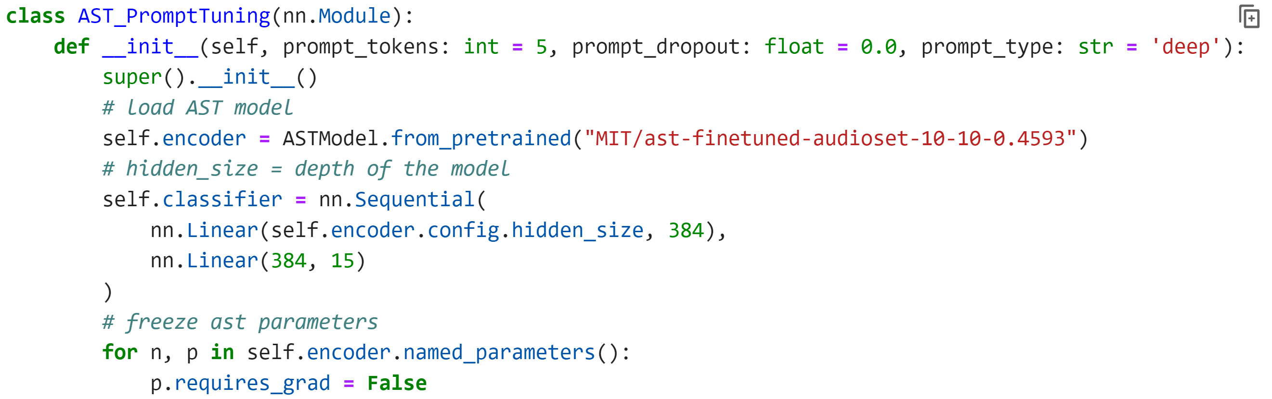
Note: THE class is called AST_Prompt-tuning, even so if the prompt_type is none is actually a pure fine-tuned network without prompt tuning

Slide 13
Prompt-Tuning
Other than fine-tuning, even if not required, we decided to do the prompt tuning of the model. The prompt tuning uses an additional set of parameters, called prompts which are integrated in the model’s input processing. These parameters are used to get a balance between performance enhancement obtained using a full fine-tuning technique (no freezing, full re-train of the pre-trained network’s parameters) and resource efficiency provided by using pre-trained freezed model and a fine-tuned classification layer.
We used basically 2 different type of prompt tuning:
Deep: A different prompt vector for each layer.
Shallow: Only a prompt vector introduced at the first layer.

Slide 14
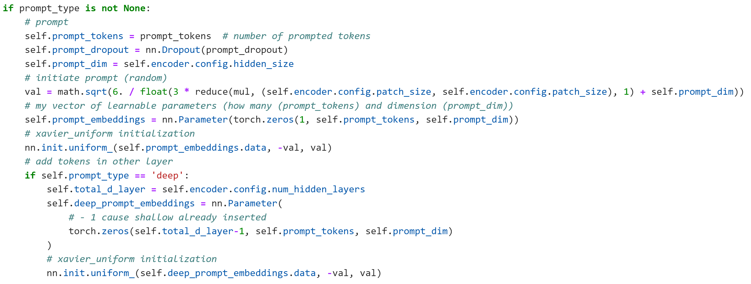

Slide 15
Cross validation
The training process is done using cross validation technique. Cross validation is used to assess model performance. During train the model is trained on full dataset k-times, changing training and test data partition. K-cross validation means split the dataset k times in different train and test set. Each split is called fold. Varying train and test set lead to remove randomness inside model performance. For each fold used to train model we collect its performance and, at the end of the process, is computed the mean and this values is assumed as model performance.
During the training and during the train phase we perform also validation phase. Validation phase aims to detect overfitting problem. Validation is done by giving in input a subset of the train set in test mode. In this way model will not update its parameters and we can trace its generalizability and therefore adjusting the hyperparameters based on validation stats.

Slide 16
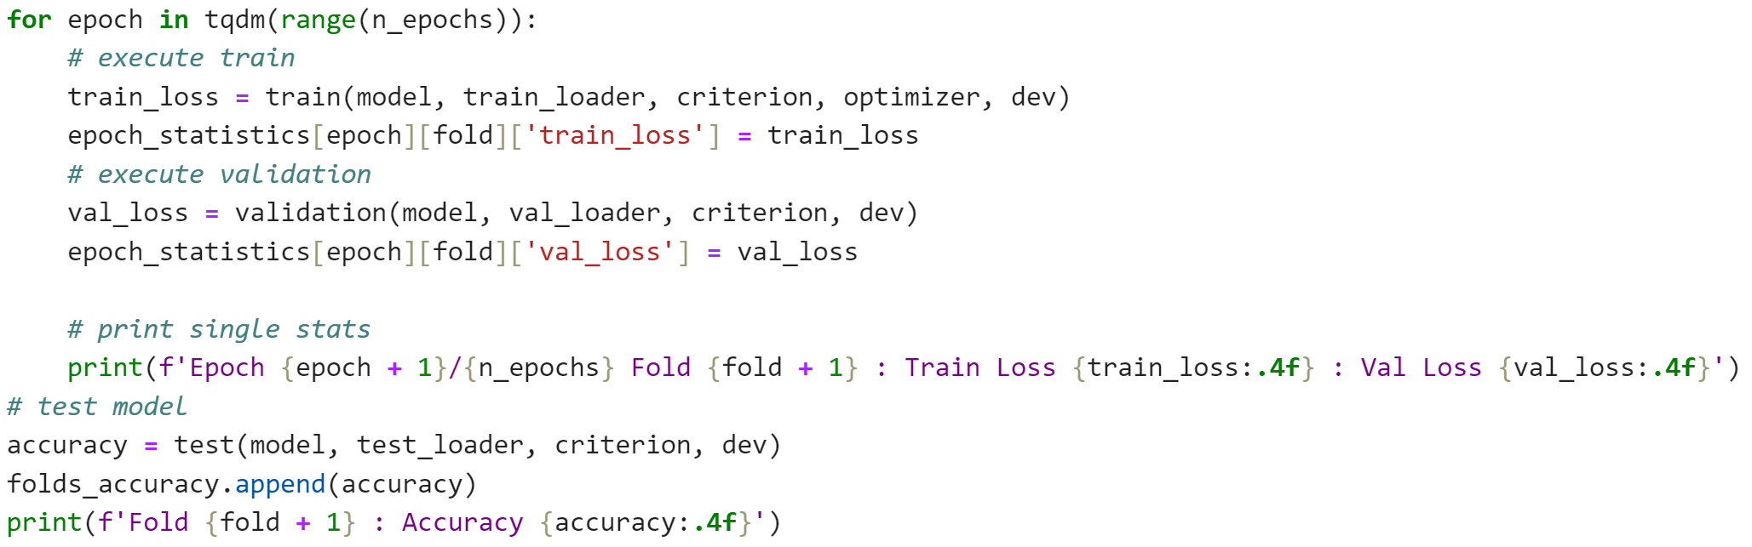
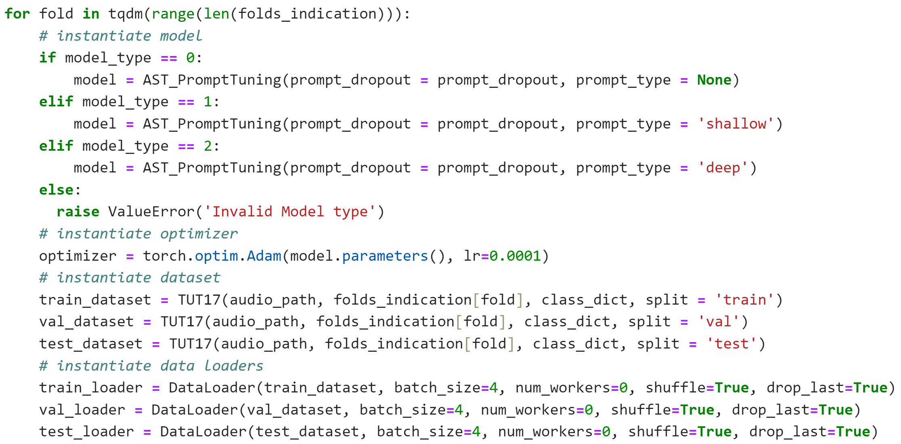

Slide 17
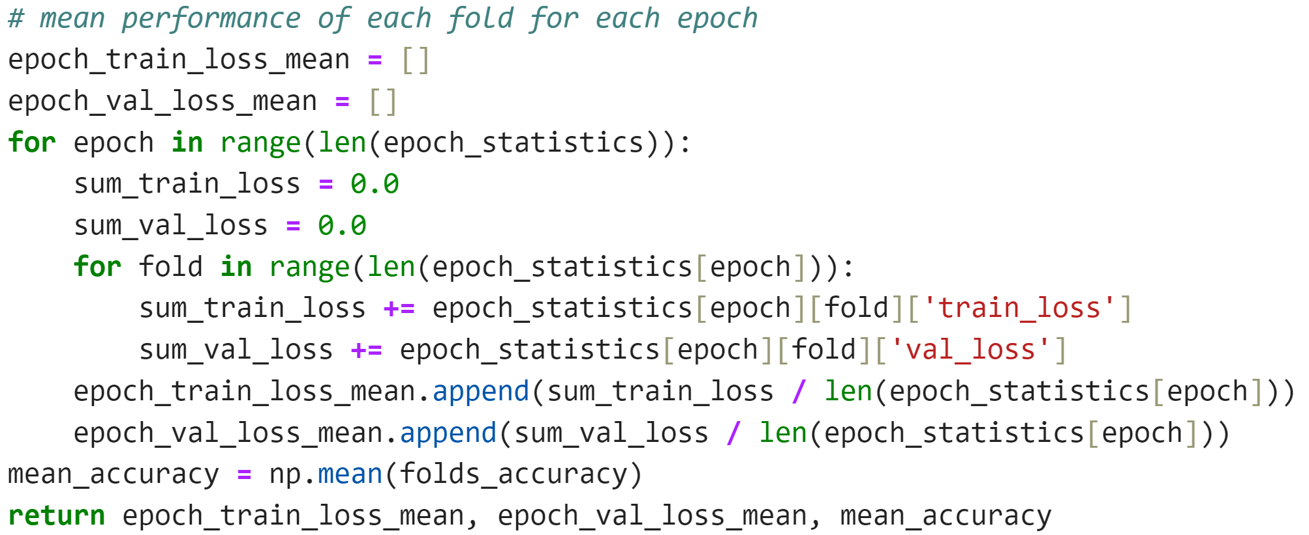

Slide 18
Training
As a first step, we trained the model for 10 epochs and for each of the 4 folds. We use a learning rate of 0.0001 to keep validation loss more stable during validation phase. At first we used a learning rate one order of magnitude greater but it caused model weights to oscillate too much preventing the model to converge to a local or global minimum. This, practically, it can be seen as an high instability of the loss statistic leading to a poor generalization capability of the model
Due to hardware limitation, we decided to train the model for a low amount of epochs. As it will be seen in the plots, subsequently reported, train loss tend to minimize while validation loss keeps a little gap but it never signal an overfitting risk.
As loss function, considering the task nature, we chose to use negative log likelihood (also referred as cross-entropy) and Adam optimizer, a stochastic gradient descend approach with an higher convergence rate.

Slide 19
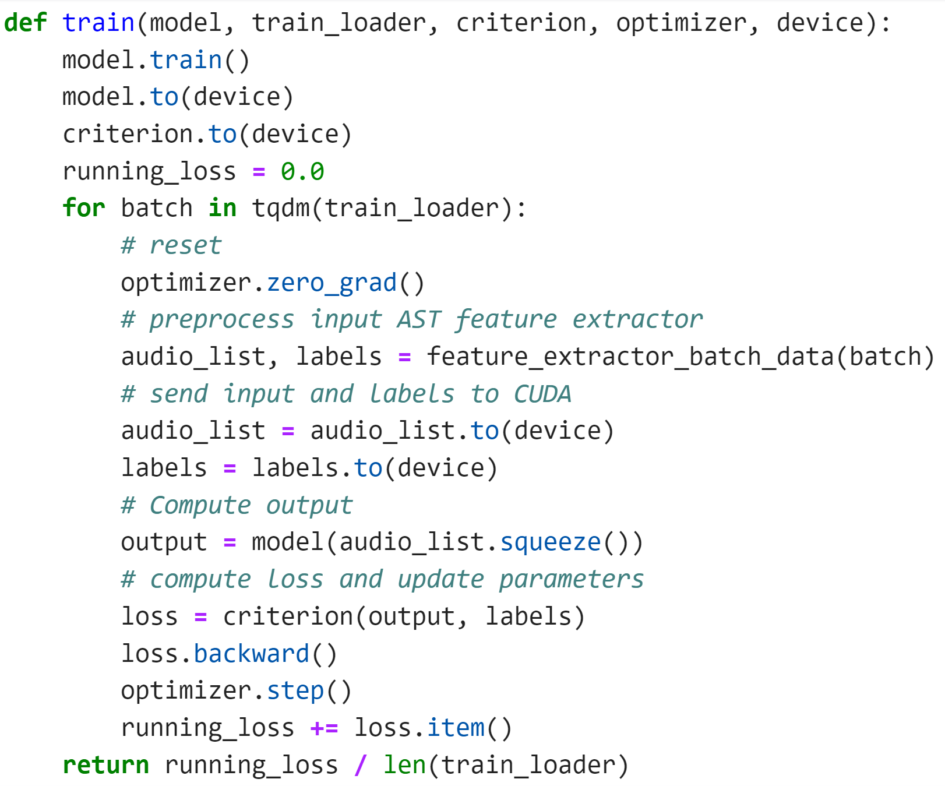

Slide 20
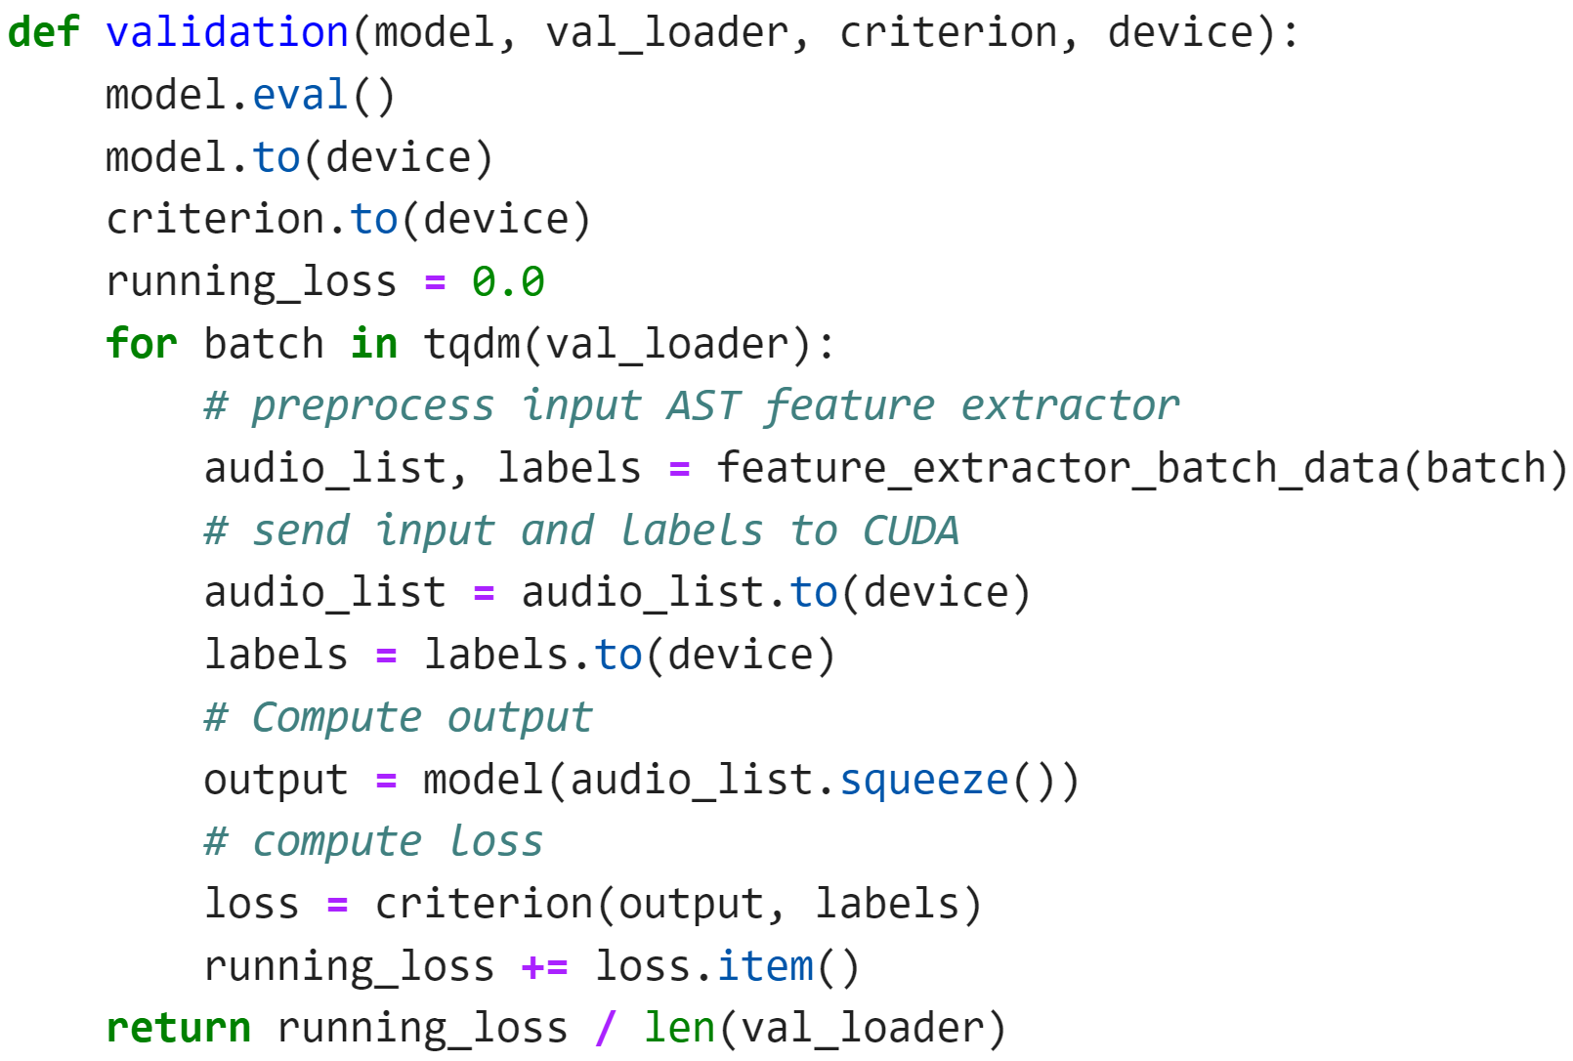

Slide 21
Results
We measure model performance by tracing training loss, validation loss and test accuracy. Each metrics was produced at each epoch and for each fold of the training process and saved in an apposite .npy file.
In the following slides, we are going to show first of all 4 different tables. These tables represents for each of the 4 folds every stats during the tenth and last epoque.
Lastly we will show some plots of the stats at each epoque to give a complete view of the model assessment.

Slide 22
Tables analysis
The 4 tables can give us a key view of the model strength and weaknesses. In particular:
When using 10% of the dataset the trend is confused, in fact there is no clearly improving using shallow prompt-tuning or deep prompt-tuning.
When using 10% of the dataset the deep prompt-tuning model has a clear deficit from classic fine-tuned model. This can be associated with the low amount of data and the performance decrease of the model given by the neurons dropout factor.
When using 50% of the dataset the trend highlights how much more performative is a model trained using deep prompt-tuning. Obtaining an increase in performance in every stats computed, with a particular improvement over validation and training losses.
When using 100% of the dataset the deep prompt-tuning model has always and clearly a better stats than classical fine-tuned model and shallow prompt-tuning.

Slide 23
10% train dataset
 | Metrics | Classic | Shallow | Deep
Fold 1 | Train Loss | 0.1931 | 0.2259 | 0.1626
 | Val Loss | 0.5958 | 0.4080 | 0.5114
 | Accuracy | 0.6857 | 0.6909 | 0.6823
Fold 2 | Train Loss | 0.2227 | 0.1948 | 0.1840
 | Val Loss | 0.3927 | 0.3859 | 0.2958
 | Accuracy | 0.7089 | 0.7097 | 0.6866
Fold 3 | Train Loss | 0.2070 | 0.1921 | 0.1752
 | Val Loss | 0.6468 | 0.5520 | 0.6811
 | Accuracy | 0.7080 | 0.6806 | 0.6806
Fold 4 | Train Loss | 0.1988 | 0.1756 | 0.1536
 | Val Loss | 0.5071 | 0.7319 | 0.6168
 | Accuracy | 0.7114 | 0.7063 | 0.7114

Slide 24
10% train dataset with dropout
 | Metrics | Classic | Shallow | Deep
Fold 1 | Train Loss | 0.1852 | 0.2072 | 0.2114
 | Val Loss | 0.7245 | 0.6530 | 0.7717
 | Accuracy | 0.7089 | 0.7320 | 0.6789
Fold 2 | Train Loss | 0.1947 | 0.2276 | 0.2505
 | Val Loss | 0.7056 | 0.6911 | 0.6489
 | Accuracy | 0.6558 | 0.7063 | 0.6866
Fold 3 | Train Loss | 0.2232 | 0.1900 | 0.2224
 | Val Loss | 0.5196 | 0.5998 | 0.6327
 | Accuracy | 0.6994 | 0.7208 | 0.6738
Fold 4 | Train Loss | 0.2013 | 0.2151 | 0.1949
 | Val Loss | 0.3512 | 0.4976 | 0.6344
 | Accuracy | 0.7003 | 0.6883 | 0.6695

Slide 25
50% train dataset
 | Metrics | Classic | Shallow | Deep
Fold 1 | Train Loss | 0.0879 | 0.1046 | 0.0557
 | Val Loss | 0.2803 | 0.3687 | 0.2067
 | Accuracy | 0.7619 | 0.7465 | 0.7559
Fold 2 | Train Loss | 0.1031 | 0.0988 | 0.0707
 | Val Loss | 0.3142 | 0.2779 | 0.1851
 | Accuracy | 0.7636 | 0.7619 | 0.7722
Fold 3 | Train Loss | 0.0845 | 0.0791 | 0.0683
 | Val Loss | 0.2277 | 0.3362 | 0.1042
 | Accuracy | 0.7654 | 0.7756 | 0.7662
Fold 4 | Train Loss | 0.1025 | 0.0857 | 0.0578
 | Val Loss | 0.2219 | 0.3452 | 0.2352
 | Accuracy | 0.7414 | 0.7756 | 0.75

Slide 26
100% train dataset
 | Metrics | Classic | Shallow | Deep
Fold 1 | Train Loss | 0.0786 | 0.0702 | 0.0476
 | Val Loss | 0.2565 | 0.2155 | 0.1176
 | Accuracy | 0.7773 | 0.7799 | 0.7953
Fold 2 | Train Loss | 0.0774 | 0.0773 | 0.0434
 | Val Loss | 0.2258 | 0.1960 | 0.0857
 | Accuracy | 0.7996 | 0.7671 | 0.7893
Fold 3 | Train Loss | 0.0778 | 0.0700 | 0.0334
 | Val Loss | 0.2205 | 0.1787 | 0.1740
 | Accuracy | 0.7859 | 0.7953 | 0.8133
Fold 4 | Train Loss | 0.0659 | 0.0756 | 0.0416
 | Val Loss | 0.2968 | 0.1804 | 0.2294
 | Accuracy | 0.7731 | 0.7765 | 0.8039

Slide 27
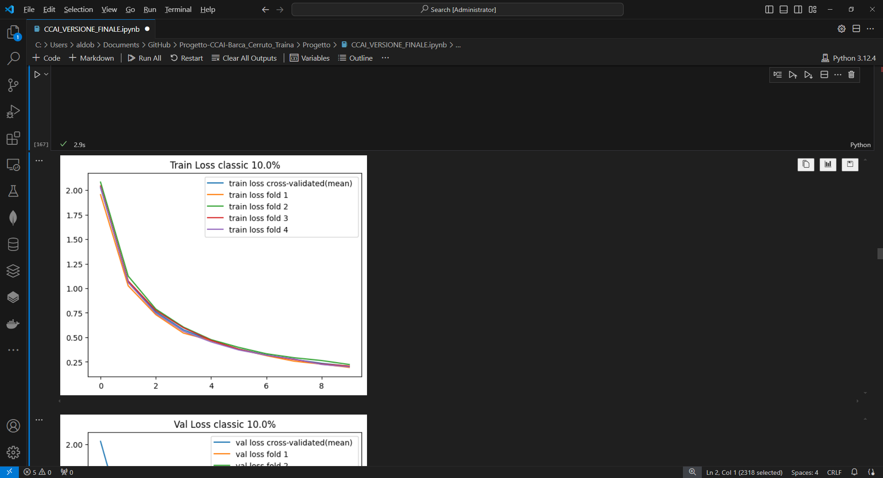
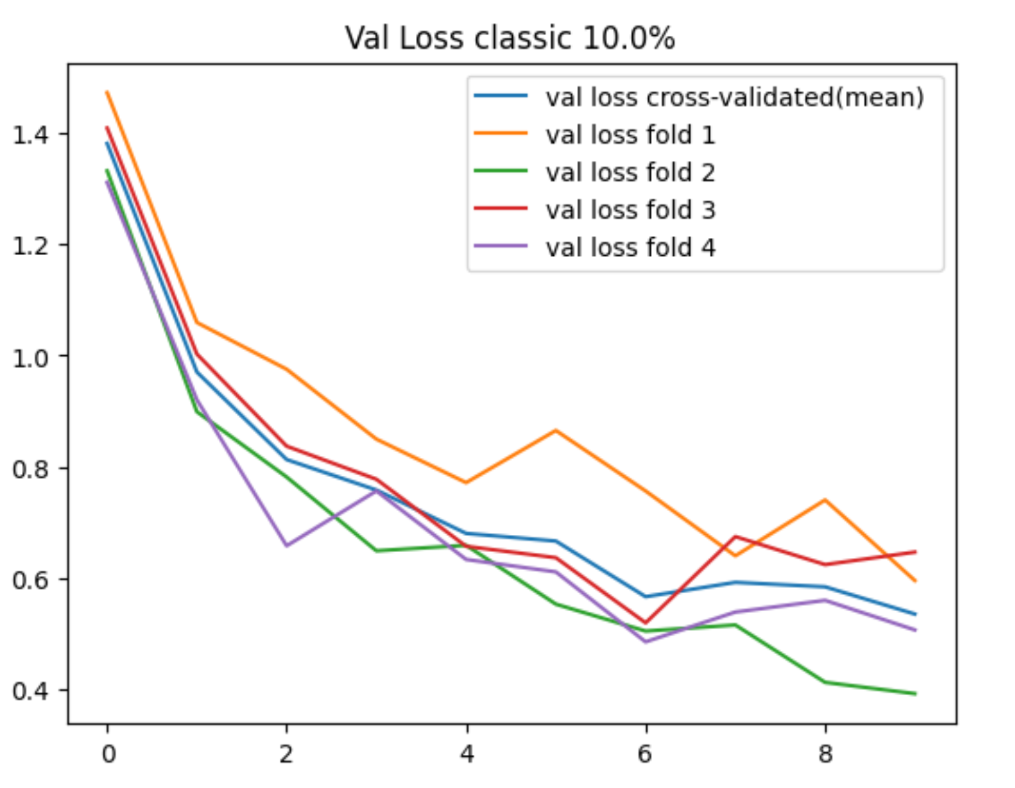
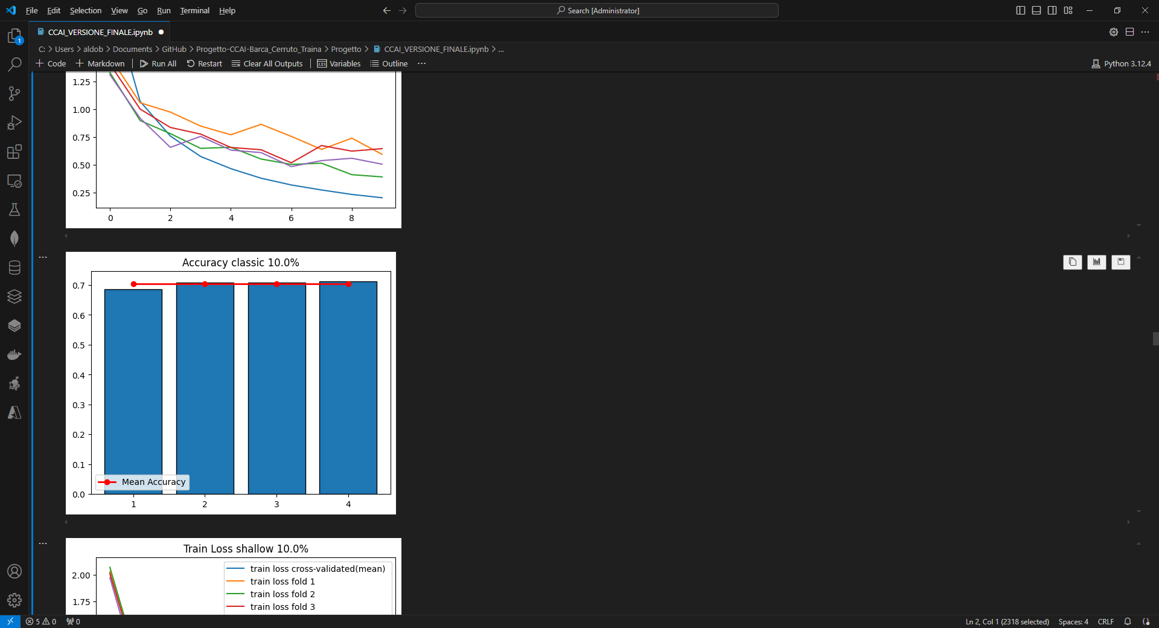
Charts

Slide 28
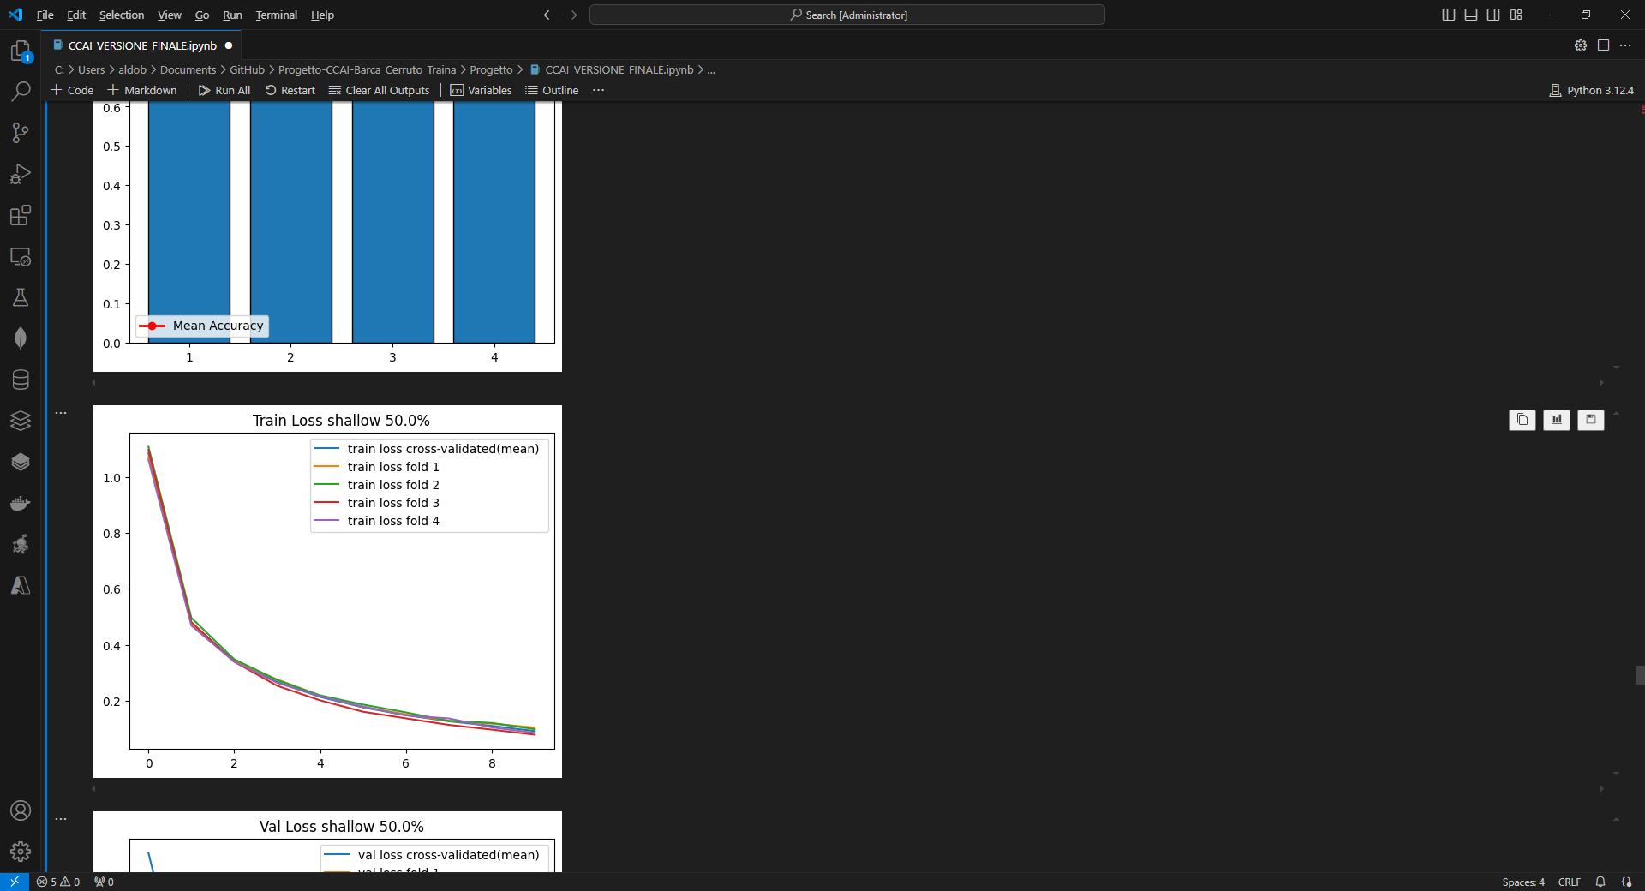
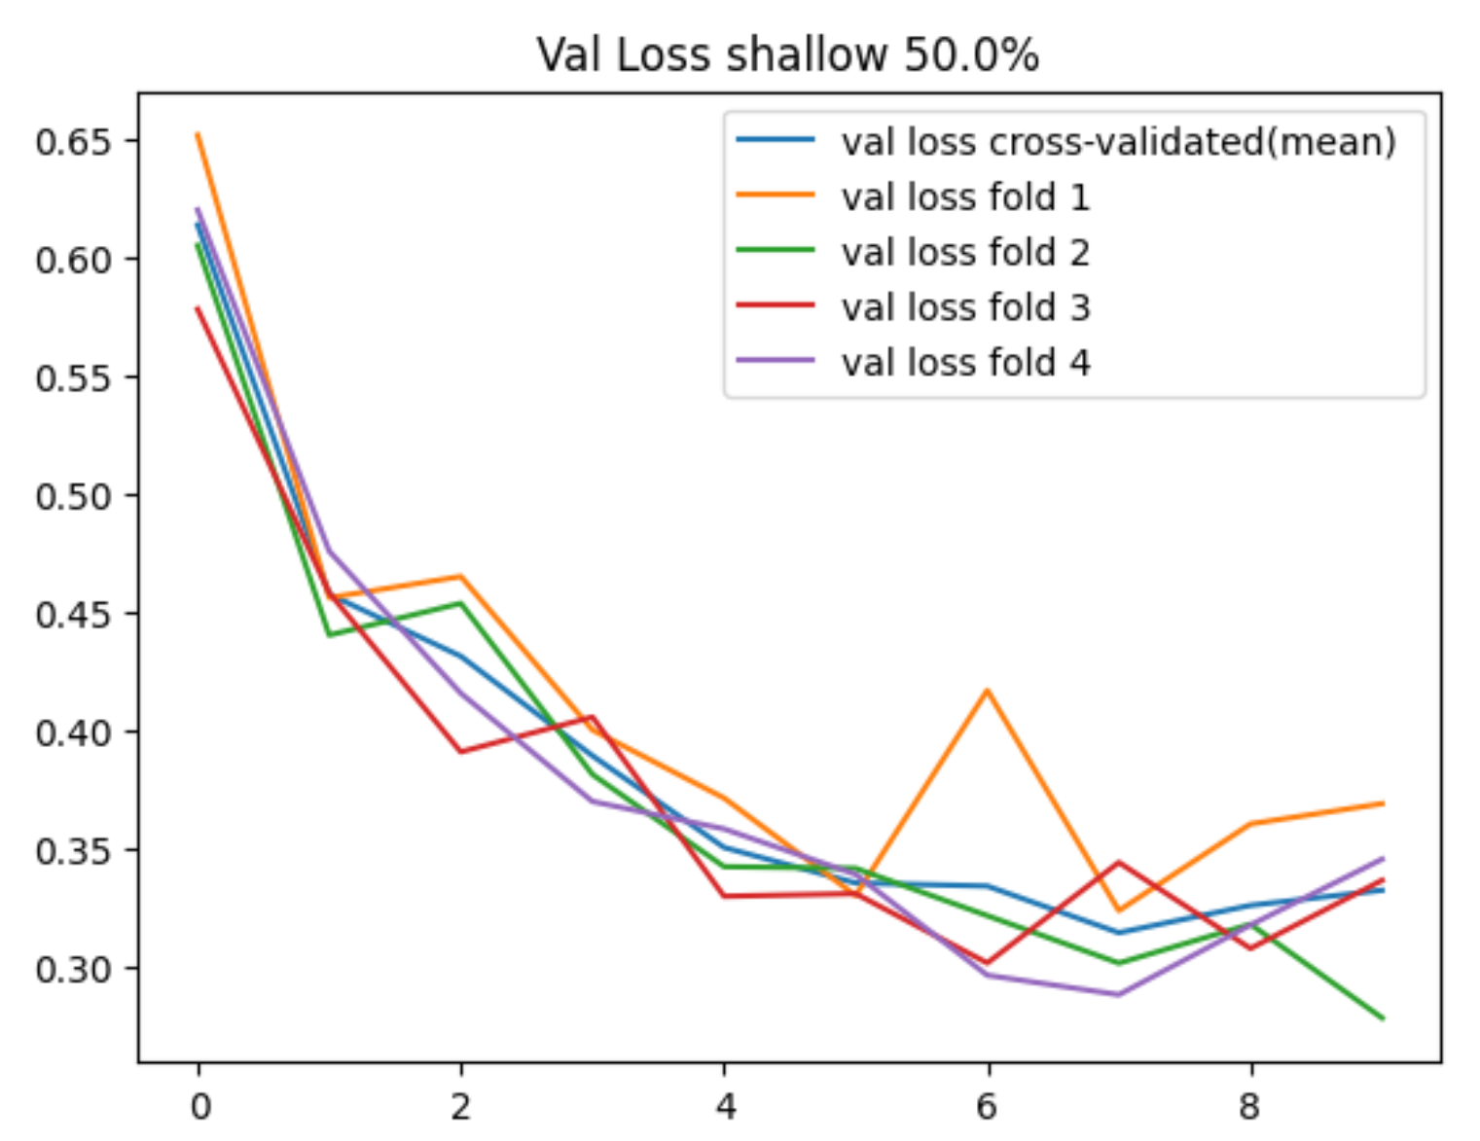
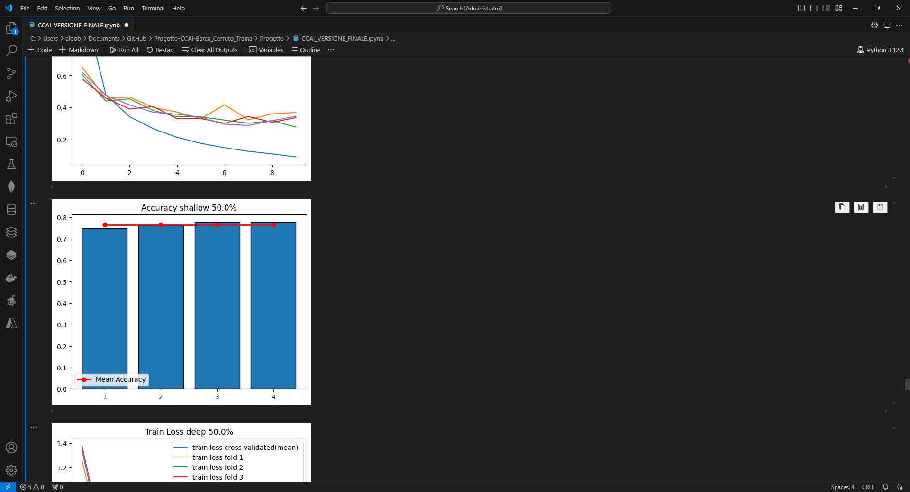
Charts

Slide 29
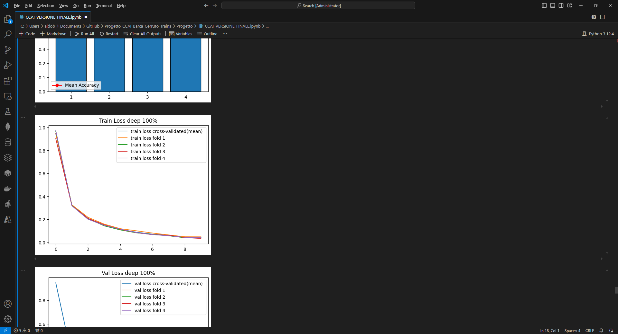
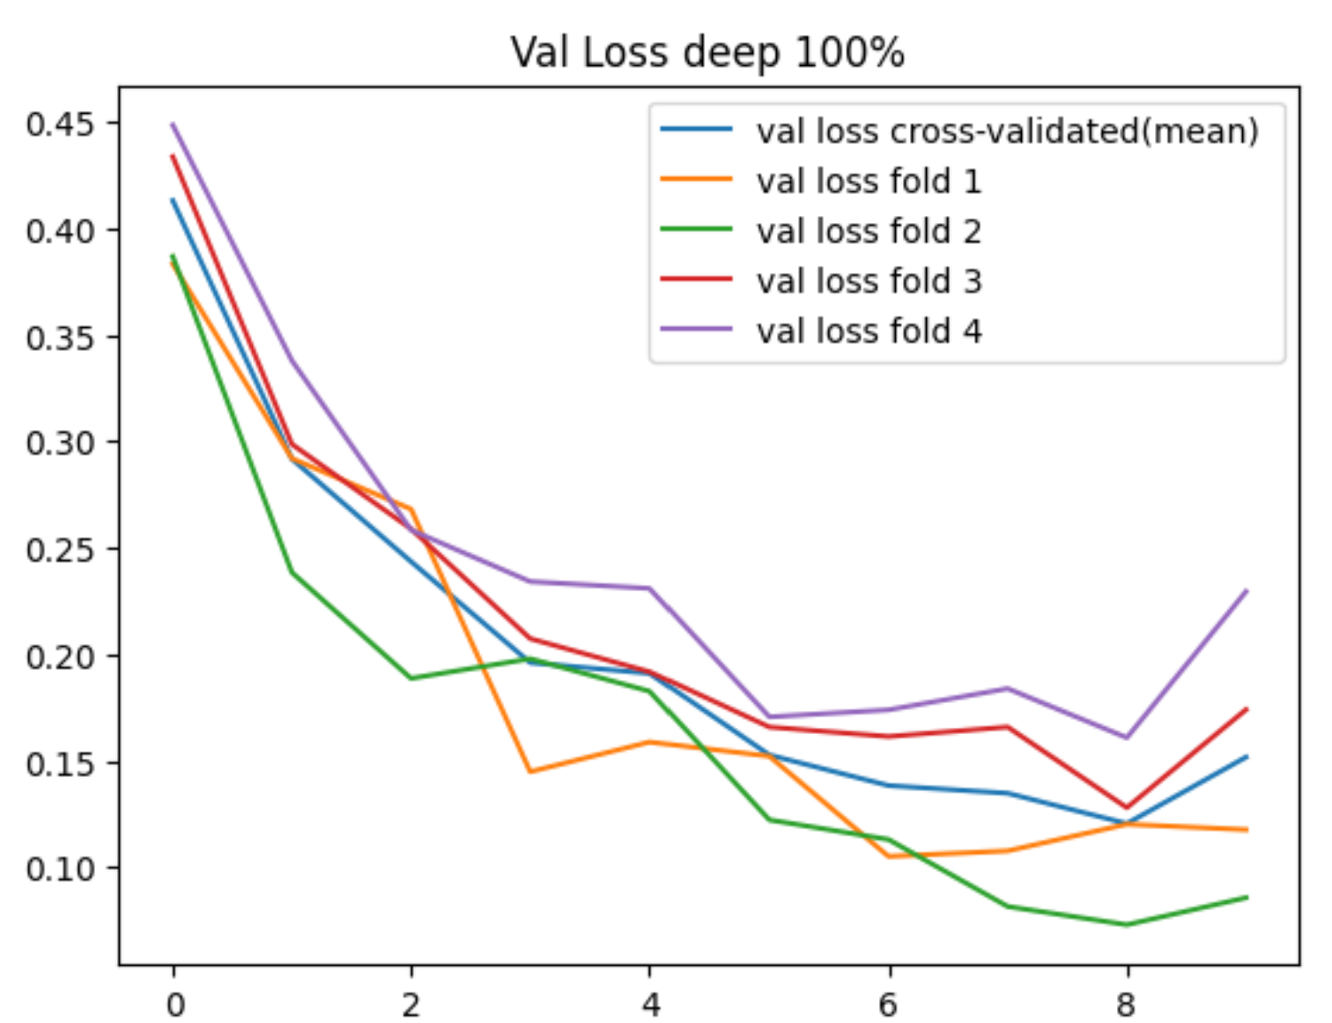
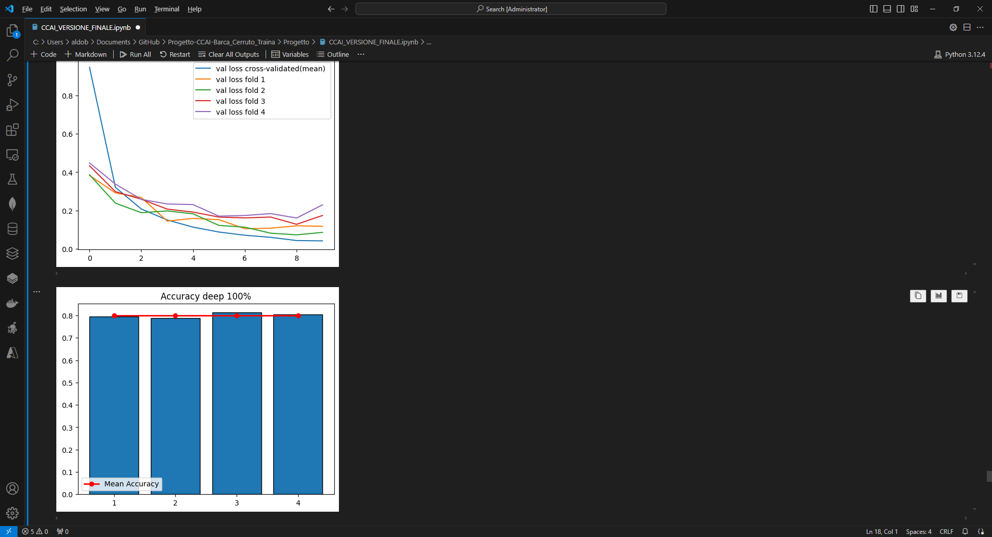
Charts

Slide 30
Inference
Moreover, we decided to perform inference using another TUT17 dataset, called Evaluation dataset. This dataset is composed by 1620 audio files taken from the same acoustic scene used during train.
We decide to use this unseen dataset to assess model performance in order to have a perfect assessment of our model capabilities.
As showed in the next slide, the model in inference phase has always an accuracy over 61% of accuracy and a maximum of 67,41%. Considering the multi-class task oriented with 15 classes (6.666% base accuracy if class are balanced) it can be shown as a satisfying inference. Even if performance during training are a little bit higher. Probably adjusting learning rate, number of training epoques and data augmentation techniques can increase the accuracy to even higher peaks.

Slide 31
Accuracy inference table
 | Classic | Shallow | Deep
10% | 63,02% | 61,73% | 64,26%
10% dropout | 64,07% | 63,33% | 63,09%
50% | 67,41% | 64,57% | 65,19%
100% | 65,99% | 64,26% | 64,26%

Slide 32
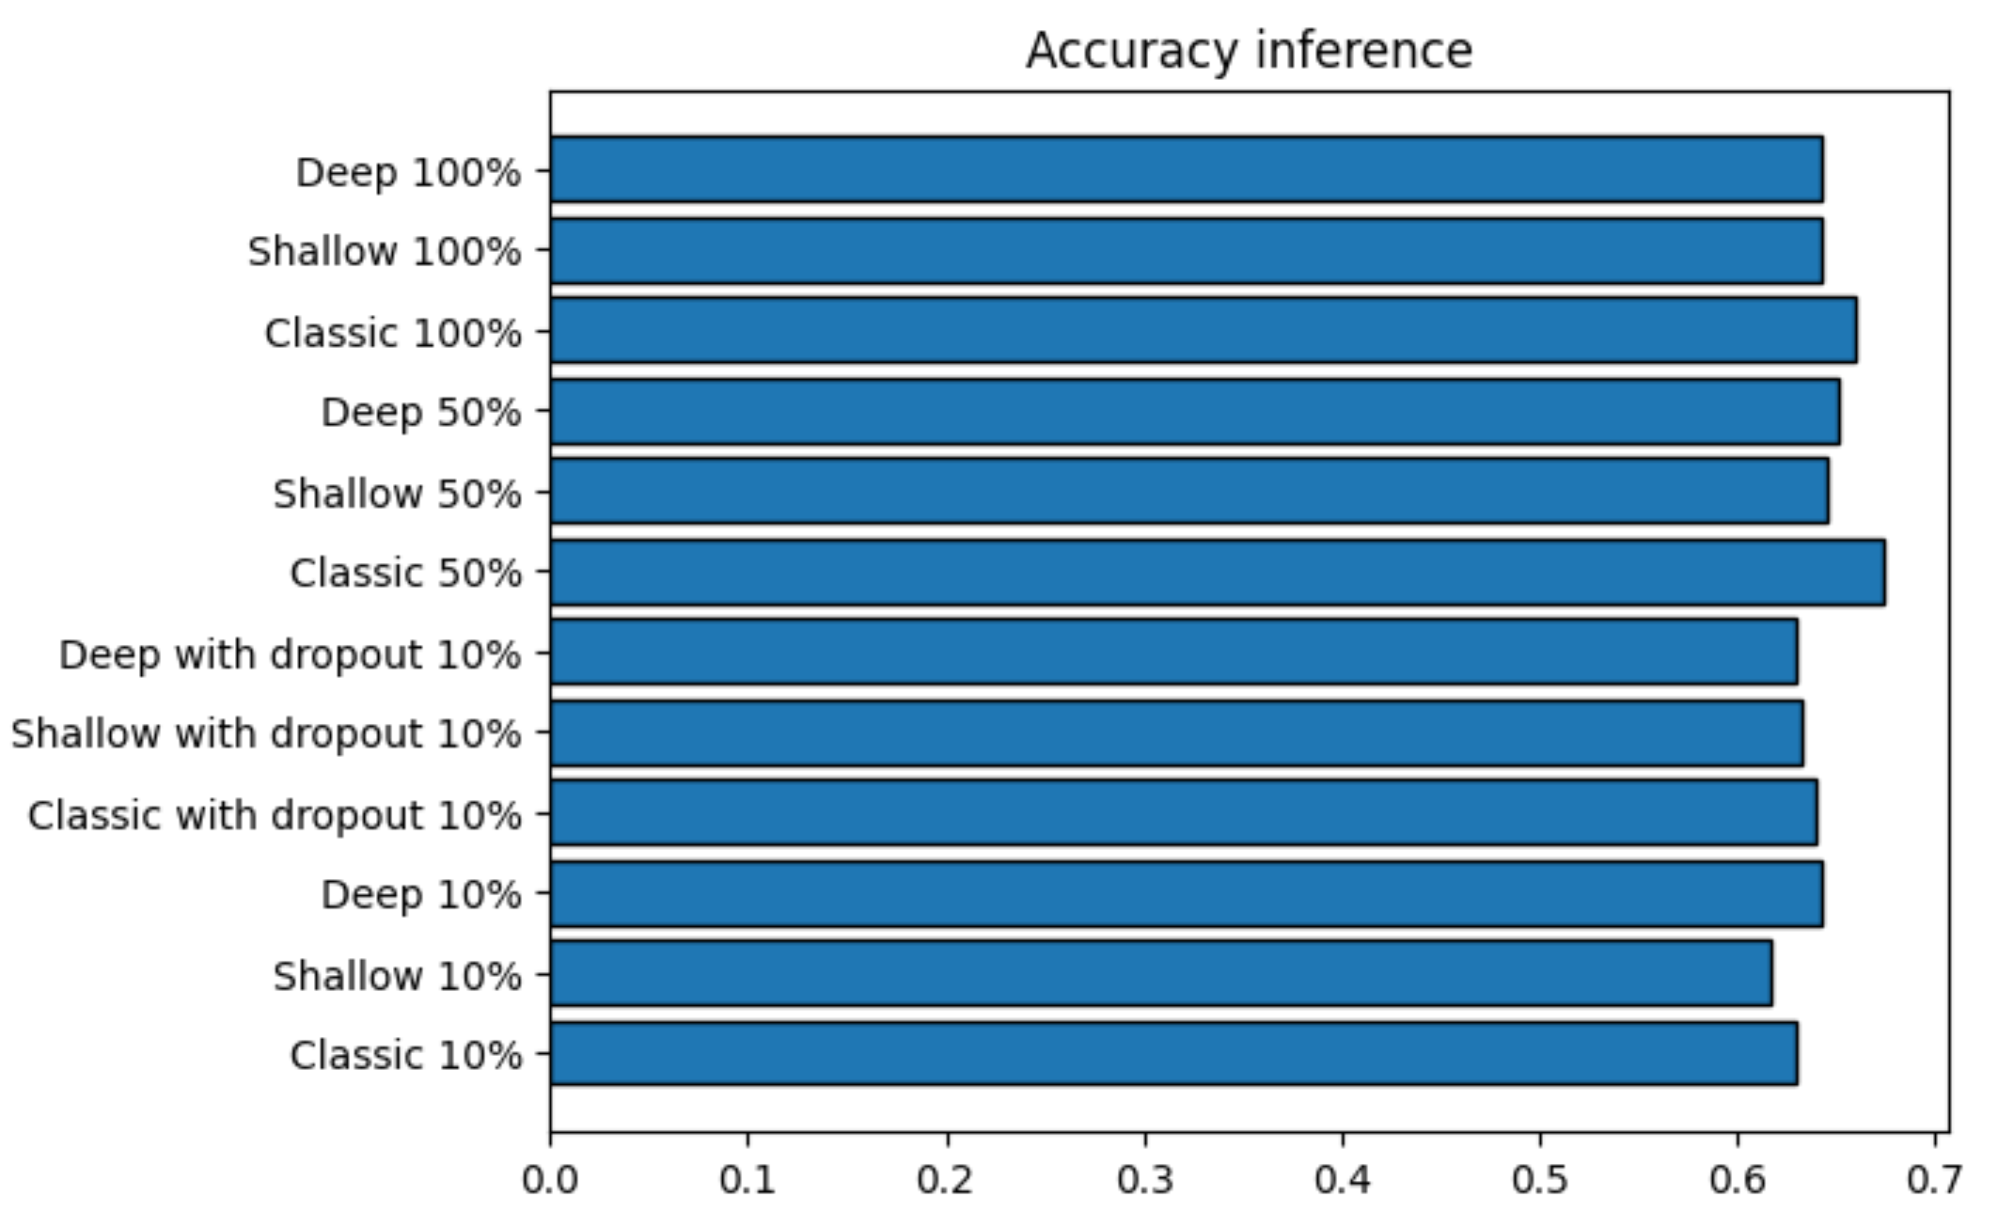

Slide 33
Inference
In conclusion we can be really satisfied about our results and the work done in the project. Even so it must be said that fine tuning using AST or transformers in general is surely an easy way to get good performances.

Slide 34




Thank you

